Slide 2
Australian beverage retail forecasting
By Felix Muriithi

Slide 3
Table of contents
01
02
03
Overview
Problem statement
Data understanding
04
05
06
Analysis
Modelling
Conclusion

Slide 4

Overview
Company XYZ is an Australian based beverage company.They sell their products through various supermarkets
Company XYZ wants to explore power of AI/ML based forecasting to replace their in house local solution.
The project will be based on using time series forecasting using Machine Learning algorithms to forecast the retail for future periods.

Slide 5
Problem Statement
The company was using their own software, written in-house, but it often produced forecasts that did not seem sensible.
This lead to overstocking or understocking of products, which can result in lost sales, increased costs, and reduced customer satisfaction.
The company needs an accurate and reliable forecasting model

Slide 6
Data understanding
The data was collected from 2017 to 2020 about the sales for the Australian Company
The date starts from 2017-02-05 to 2020-12-27
The data has 12 columns and 1218 rows
The data has no missing values and no duplicates
Each product was perfectly balanced

Slide 7
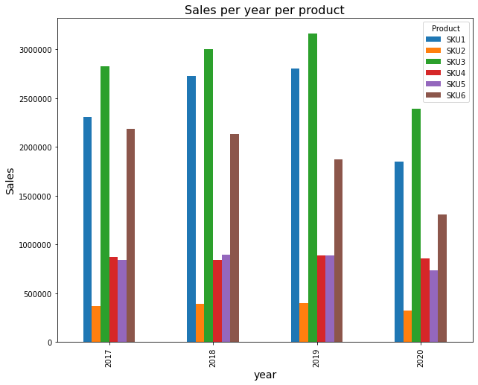
Sales per year
SKU1 and SKU3 had the highest sales in all the years
SKU2 has the lowest sales in all the years
SKU6 has the third highest Sales in all the years

Slide 8
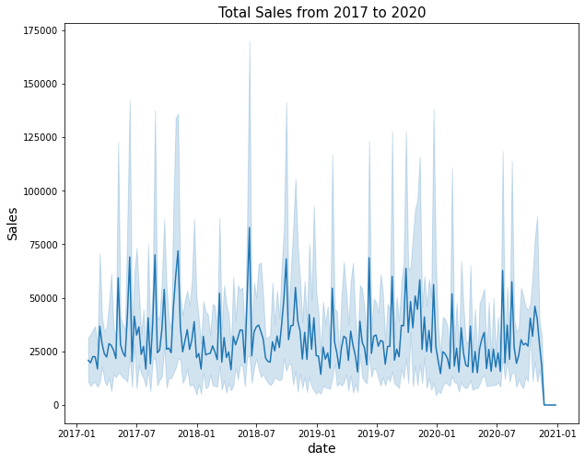
Total Sales from 2017 to 2020
There is a hike in sales around July every year
There is downward trend in sales around September in 2020
The sales have a constant trend

Slide 9
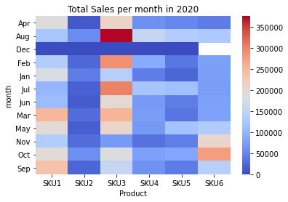
Sales per month in 2020
December had the least sales in 2020
SKU3 has the highest sales in August and February
SKU6 has the third highest sales in October

Slide 10
Modelling
 | Forecast accuracy | Mean absolute error
ARIMA | 0.92 | 25407
ARIMAX | 0.96 | 24941
SARIMA | 0.94 | 31642
SARIMAX | 1 | 20662
Facebook prophet | 1 | 17769
The following models in the table were used in the project
The success criteria was a forecast accuracy greater than 0.9 and with the least mean absolute error
The model that performed best is the facebook prophet model

Slide 11
Conclusion
The constant trend in Sales should be improve by increasing demand through advertisements
The major limitation was working with limited data for different products each being modelled separately.
The other limitation is just trying out more models
Based on our findings,
we recommend that the company use the facebook prophet model(model_tune) to inform their decision-making around inventory management and production planning,
and to continue to refine and improve the model over time

Slide 12

Next Steps
To use deep learning models that is RNNs and LSTMs to train the data for better accuracy
To scale the facebook prophet model to be able to handle big data
To do more analysis on the data

Slide 13
Thanks
Do you have any questions?
fnyagah67@gmail.com
+254796470136
linkedIn
Please keep this slide for attribution

